Slide 1


Segmenting Consumers of Bath Soap
Gordon W. Wall
Designed for CRISA

Slide 2
Problem and Formulation
CRISA believes demographic segmenting not as effective as purchase behavior/basis. Objectives:
Cluster for Purchase Behavior, Basis, and Both
Select Ideal Segmentation (by loyalty, basis, and demographics)
Develop Classification Model for New Data
Problems:
Variable Selection?
How to gauge loyalty?
Optimal Clusters?
Best Segmentation?
How many groupings?

Slide 3
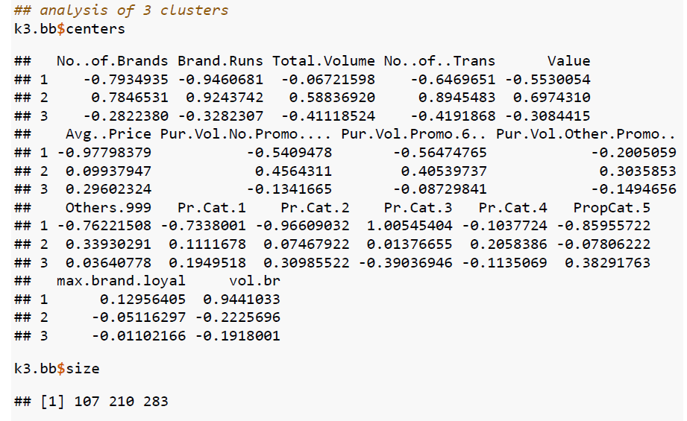
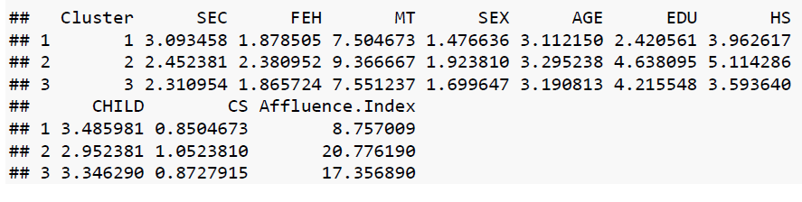
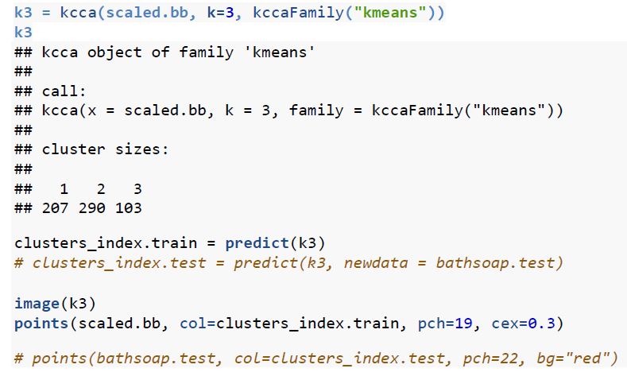
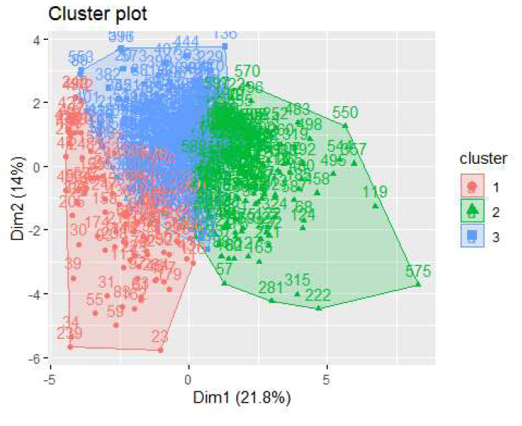
Objective-Based Results

Slide 4
Conclusion
Ideal Segmentation: Ideal k = 3. Cluster 1; low SEC, low EDU, high loyalty, low volume/value. Cluster 2; high SEC, high EDU, high AFI, high volume/value, low loyalty. Cluster 3; highest SEC, high EDU but young AGE, high PRCAT, high value, neutral loyalty.
Implementation: Classification model for these target segments, or custom tailoring to individual clients with specific goals

